Slide 1
This slide is intentionally left blank.
A reminder, only put Google product related knowledge in this ppt.
e.g., knowledge about GCP, Google Home, Tensor flow, etc.

Slide 2
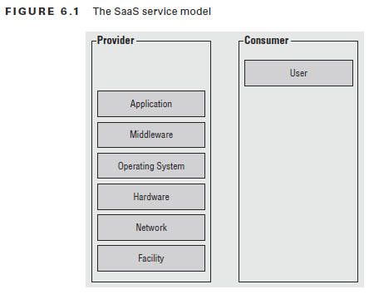
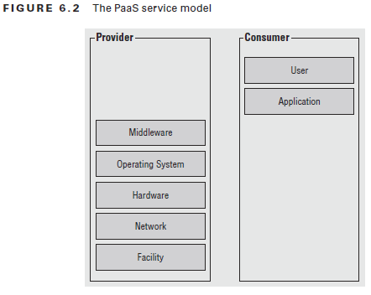
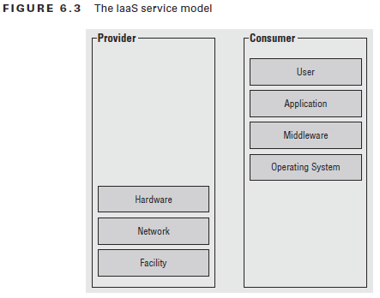
SaaS, Paas, Iaas structures.
Paas let you bind your application code to libraries that give access to the infrastructure your application needs
Iaas provide raw compute, storage, and network, organized in ways that are familiar from physical data centers

Slide 3
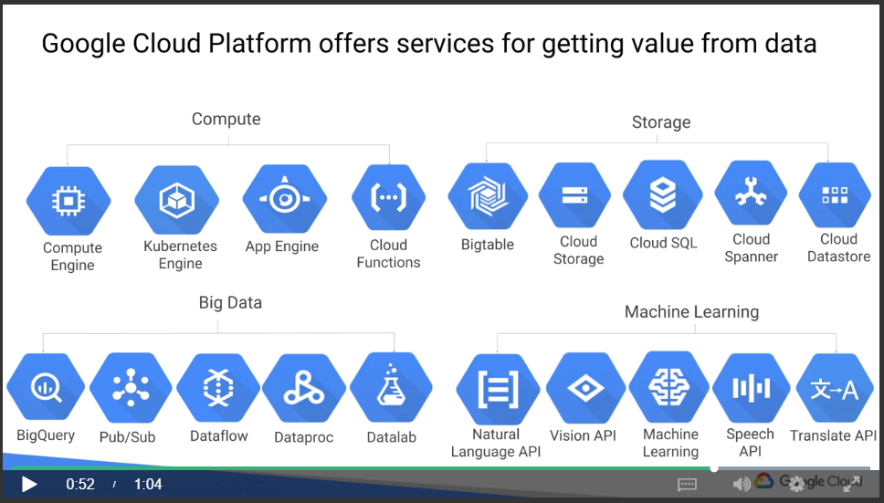
Services from Google Cloud Platform (GCP):
GCP has 4 big components: Compute, Storage, Big Data and Machine Learning
The sub categories are shown as follow.
* from Coursera

Slide 4
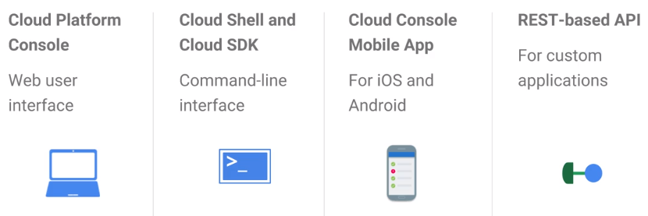
GCP中，必须有一个Organization code
所有的GCP的resource都必须属于一个project，以便管理
IAM中，有primitive role和predefined role
Primitive role包括owner/editor/viewer；这个比较广，在人多的情况下需要细分；不能改变；Primitive role是给project的(primitive role＝project role)
Predefined role细分了Who can do WHAT；predefined role是给project下的user的
Service account does (service account is for an App, NOT for a person):
Authenticate between GCP services
A way to restrict the actions a resource (e.g., VMs) can perform
A way to allow users to act with service account permissions
Key generation and rotation when used with App Engine and Compute Engine
About Compute Engines (VMs):
Preemptible VMs are highly affordable, short-lived compute instances suitable for batch jobs and fault-tolerant workloads.

Slide 5
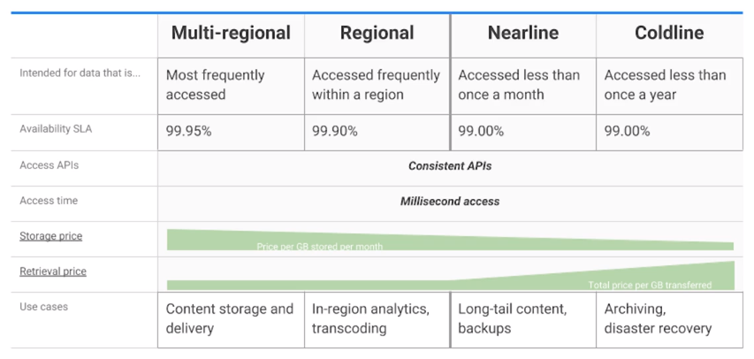
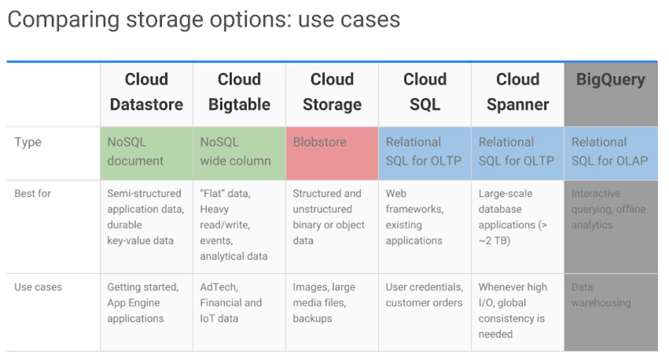
For Infrequently accessed data (1 per month)
For Infrequently accessed data (1 per year)
Storage:
Cloud storage
No sql
Buckets, can control ACL (Access Control Lists) for each buckets
Can turn on/off overwrite (just like git, can track history)
这个storage就感觉和Google Drive相似，可直接存文件
有4个种类，见右图
is often the ingestion point for data being moved into the cloud, and is frequently the long-term storage location for data
Good for immutable (一成不变的) binary objects
Cloud sql
mySQL and PostgreSQL as service
Use this if you just needed to migrate a standard relational database running on a single machine in a datacenter to the cloud
Cloud spanner
Same as cloud sql
Good for a relational database with SQL queries and horizontal scalability
Cloud data store
To store object data from app engine
Good for structured objects with transactions and SQL-like queries
Google big table
Is a managed NoSQL
Good for structured objects, with lookup based on a single key
以上４種類のStorageのUsercaseは、右：

Slide 6
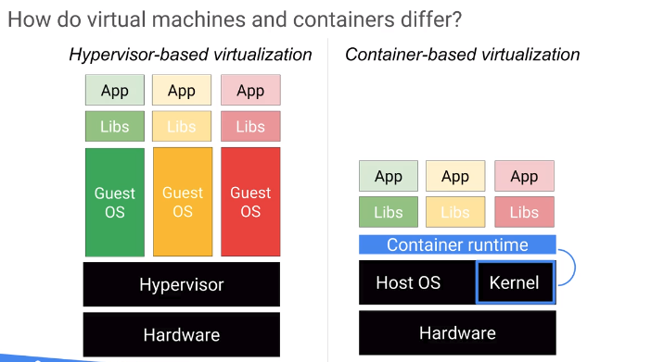
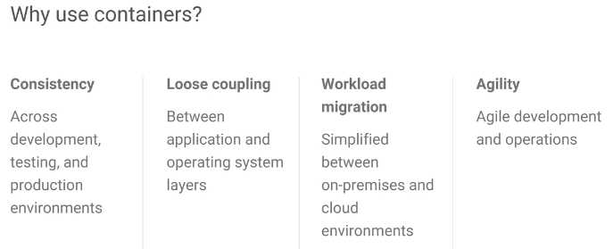
Container:
A substitute for VMs. (两者都是在同一Hardware上实现isolated虚拟环境的方法)
Kubernetes Engine is used to manage the containers.
Require low overhead.
Vm和container的不同见右图
比VM的启动速度更快，消耗资源更少
Kubernetes:
Use Pod, which is a group of containers, in deployment. (我把我的subsystem装到一个container里，别人把别人的subsystem装到一个container里，然后2个container装到一个pod里)
Kubernetes cluster nodes是VM instances
Compute Engine and Kubernetes Engine are used to provide compute infrastructure for applications.
我的理解是Compute Engine (a.k.a VMs)和Kubernetes Engine (a.k.a Containers)是实现同一个目的的两个工具
每个VM都有自己的OS；
所以VM的boot会slow，
并且resource heavy
Container是基于OS的每一个process(并且其memory space)都是isolated
概括一下就是，Container只提供app所需要的最少libs，
所以app deploy会变得非常快

Slide 7
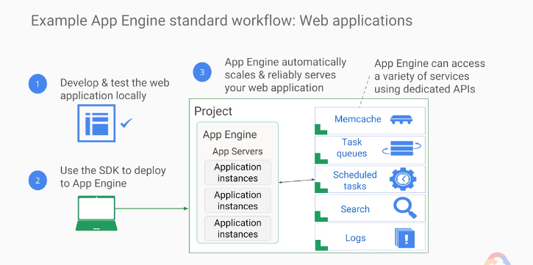
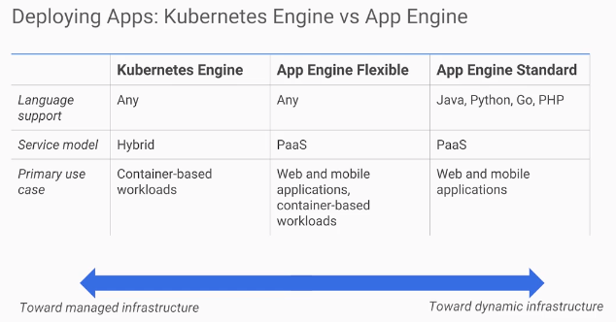
App Engine:
Unlike Compute Engine and Kubernetes Engine, which focus on Infrastructure, App Engine focuses on Code
当deploy app时，只需要给app engine code，然后app engine搞定其他，如load balancing, logging等
有两个environments，standard和flexible
Standard提供runtime，针对java，go，php等语言(没C/C++)
Standard提供sandbox
Flexible和container一起，app在container里，container在VM上
App engine的test和deploy方法见右图
Kubernetes和App Engine的不同，我的理解是，Kubernetes需要自己config infra和code，但app，特别是standard只需要关心code
Cloud Endpoints:
和API有关，当你想知道谁，在什么时候，怎么用你提供的API，用了几次的时候，用这个
专用语API logging and monitoring
Apigee Edge:
A platform for making APIs available to your customers and partners.
一般用于business analytics and billing

Slide 8
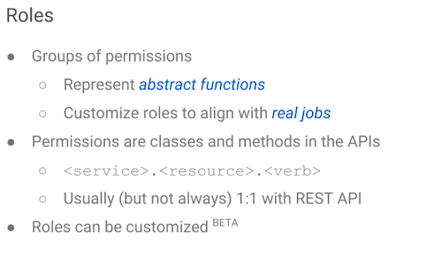
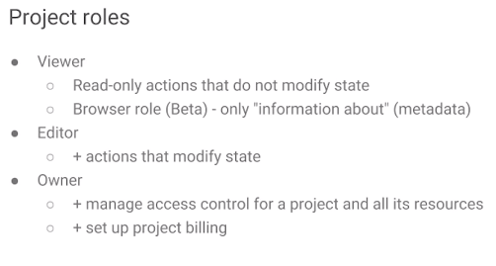
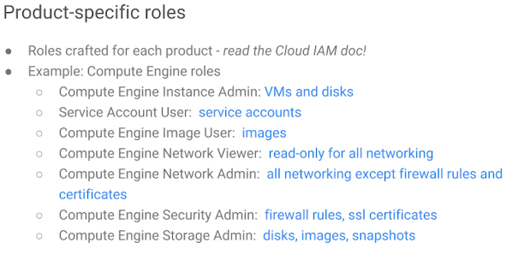
Cloud Source Repository:
Customers no need to maintain git instance themselves
Is a cloud version of Git; can be managed by IAM
Cloud Function:
Is a javascript that respond to events without a server or runtime
Define events as triggers; then attach javascripts to those triggers
Trigger example: some new image is uploaded
Deployment Manager:
needs a template to define what the environment should look like
Is an infrastructure management system for GCP resources.
Stackdriver:
Is a tool for monitoring, logging and diagnostics.
Core components: monitoring, logging, trace, error reporting, debugger.
似乎是第三方app，也可以监视AWS cloud
Logging机能允许用户define metrics on logs
Project roles是所有GCP project共通的，Product-specific role是根据用的GCP service而定的

Slide 9
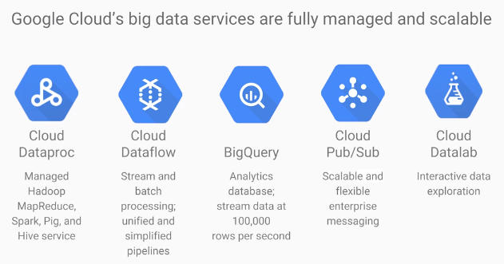
BigQuery
Used for SQL queries on a massive dataset
can take in a .csv and do query using SQL
Cloud Pub/Sub
Is a messaging service
Publisher/subscriber model
Good for Internet of Things app
和bucket连用，当新item加入到bucket的时候，自动通知app
Cloud Datalab
Aka. Python Jupiter web notebook
Apache Hadoop
Based on MapReduce programming model
Dataproc
Is a way to ran Hadoop, Spark, Hive and Pig on GCP
Charged by minutes
Next step is to use Mlib (apache machine learning lib)
Dataflow
data shows up in real time or it's of unpredictable size or rate
Use pipeline

Slide 10
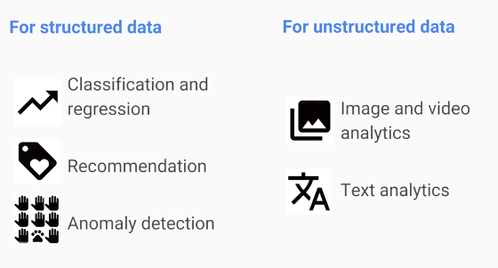
Cloud Machine Learning Platform:
For structured data
For unstructured data
APIs:
Cloud Vision API
Cloud Speech API
Natural Language API
Cloud Video Intelligence API

Slide 11
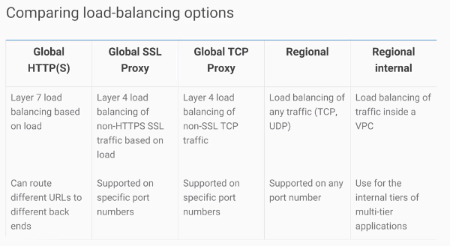
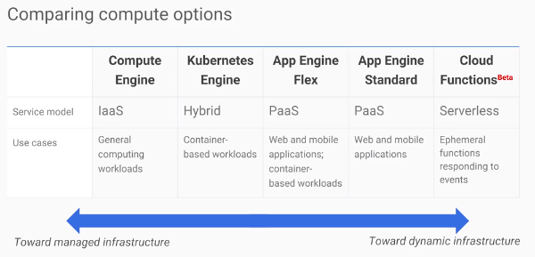
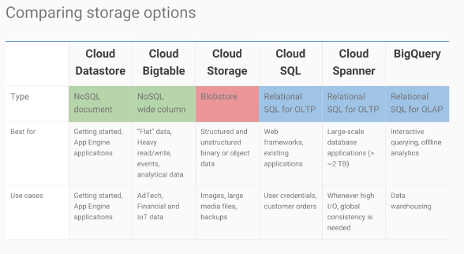
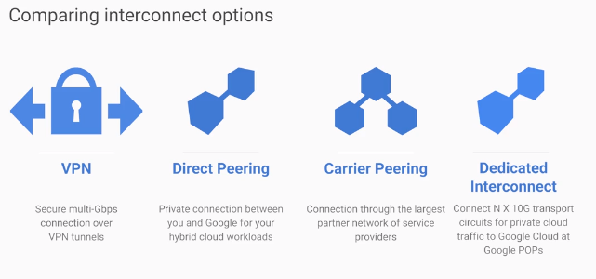
Summary
以下是GCP主要提供的各种功能
最简单的接VPN进Virtual Personal Cloud的方法是cloud router

Slide 12
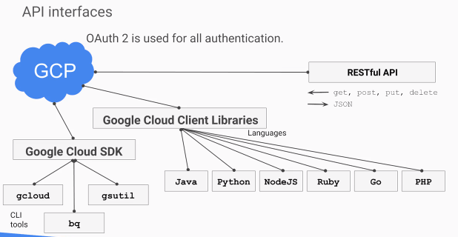
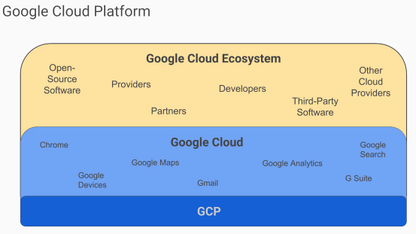
What is GCP
2 user interfaces GCP provides:
Cloud shell (a.k.a, a terminal)
Cloud console (a.k.a, the browser UI interface)

Slide 13
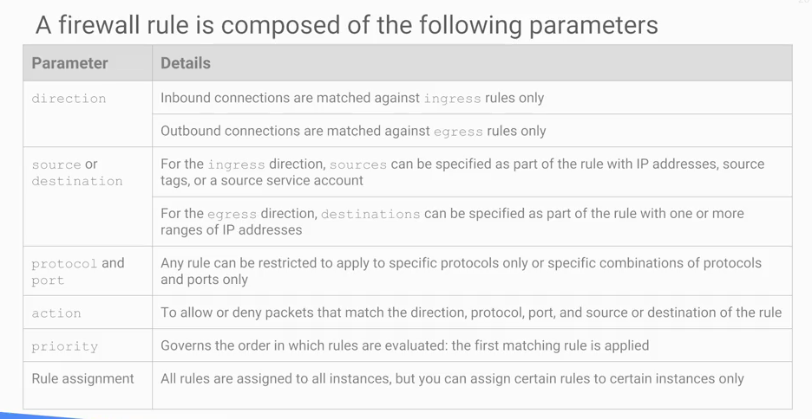
Firewalls
不只是GCP，下图知识适用于所有firewall

Slide 14
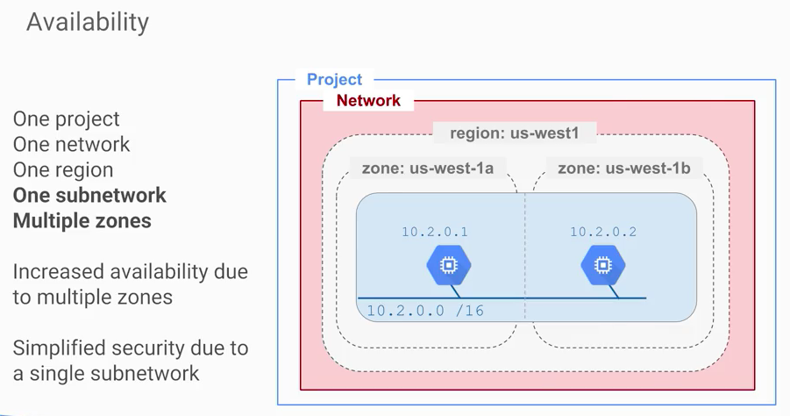
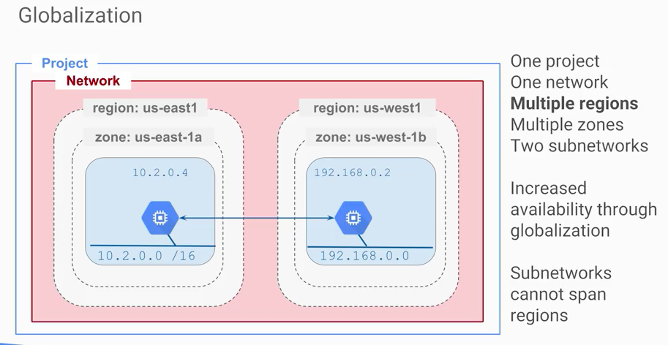
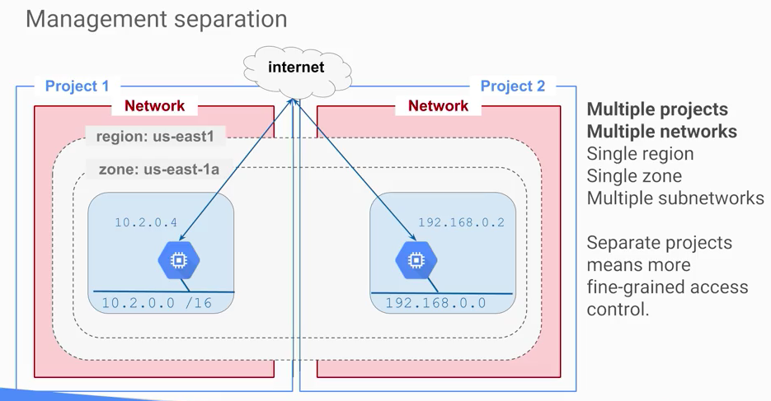
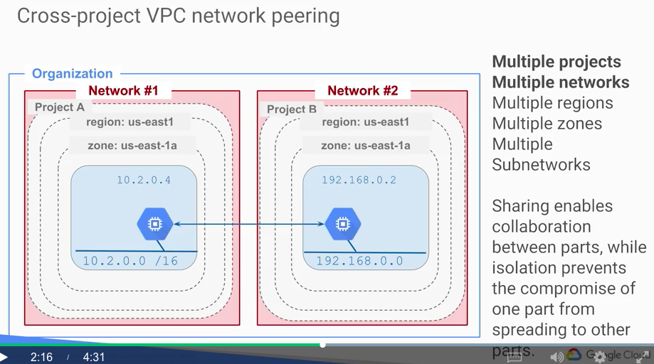
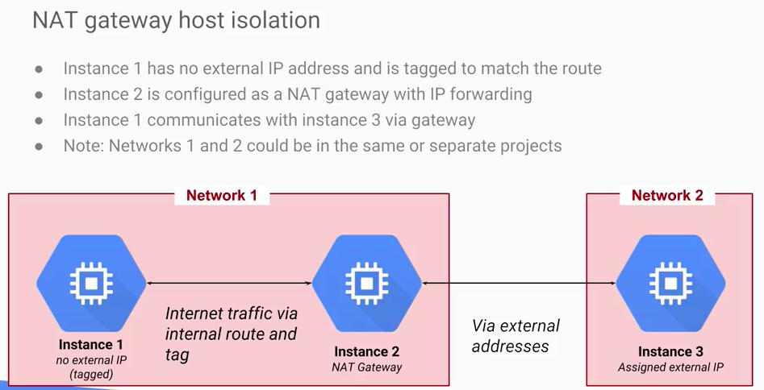
GCP设定里有3种network type：default、auto、custom
几种network design以及其好处
Globalization型的design比availability型有更高的failure robustness，但是security会变复杂
第三种cross-project VPC，这种设计能确保一个project的failure不影响另一方
第四种，management separation is better for identity and access management，比如说设计者属于project 1，开发者属于project 2
第五种，NAT gateway（也叫bastion）相当于一个access proxy，这个设计更安全(A best practice for infrastructure administration is to limit access to the resources. In this lab, you learn one method of hardening an infrastructure called a Bastion Host.)

Slide 15
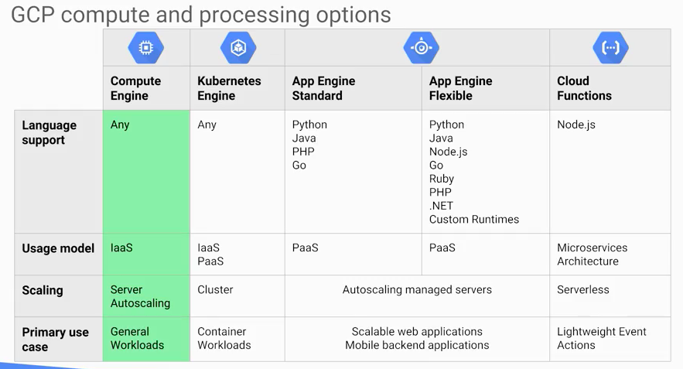
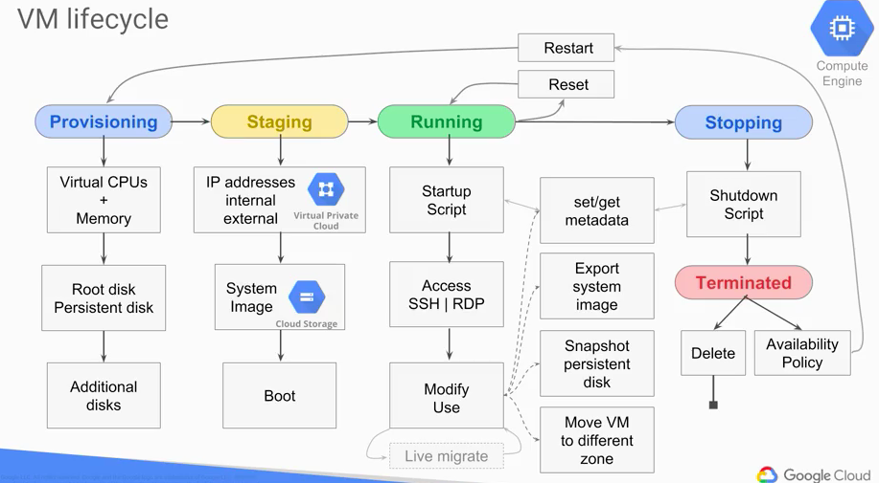
GCP提供的几种计算entity，以及其attributes
这个slide先着重看Compute Engine（VM）
VM lifecycle见下图
Vm硬件config中有vCPU ; disk的选项有standard，SSD和local SSD，其中local SSD一般用于暂时的data transfer

Slide 16
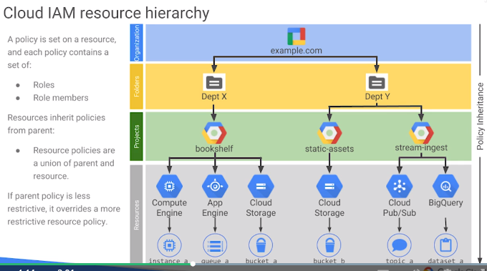
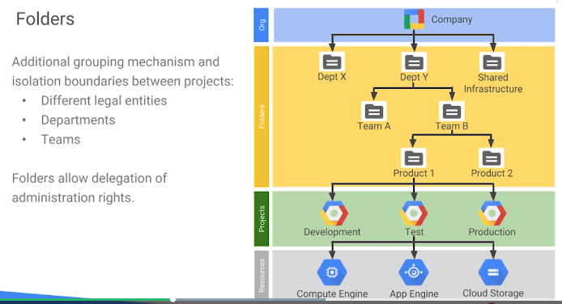
Best practice to organize GCP hierarchy

Slide 17
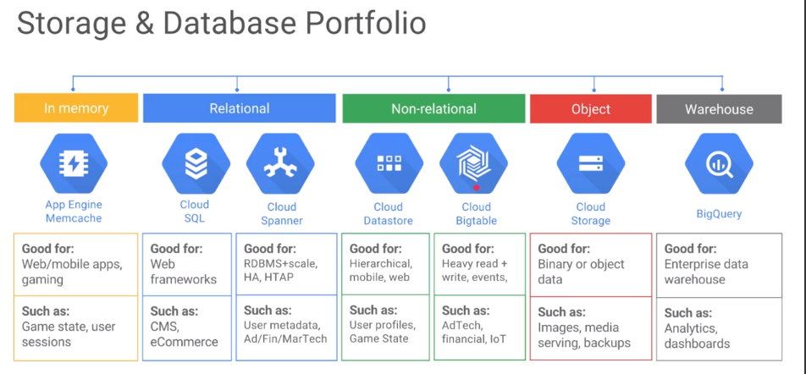
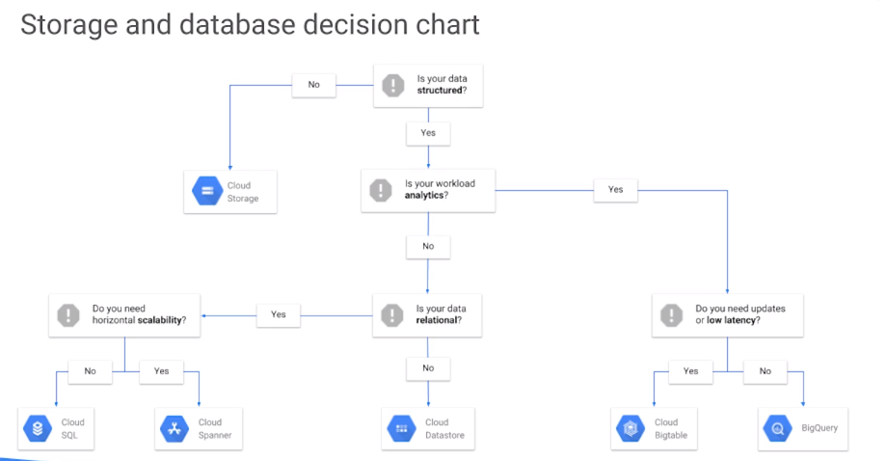
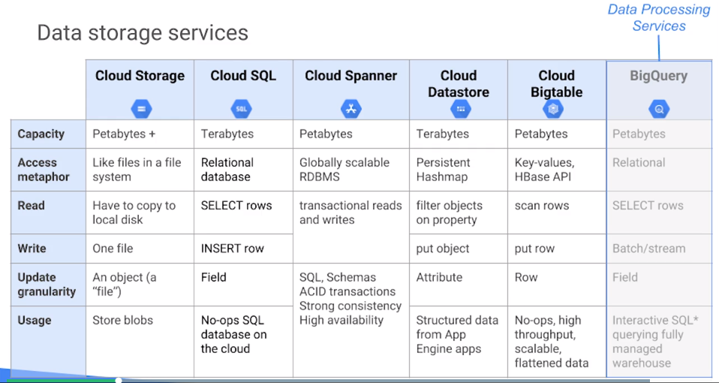
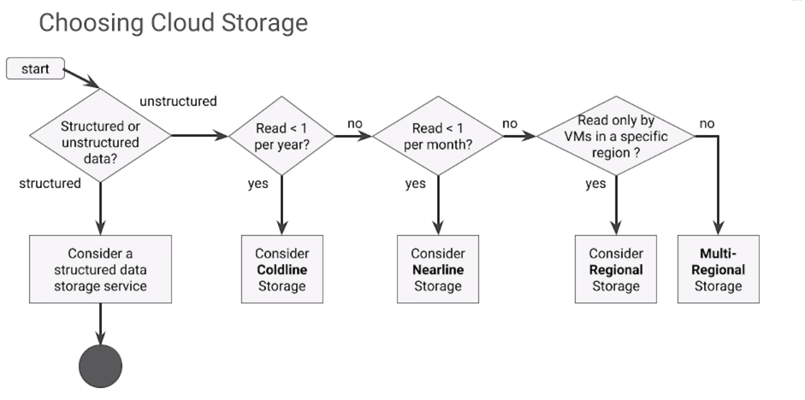
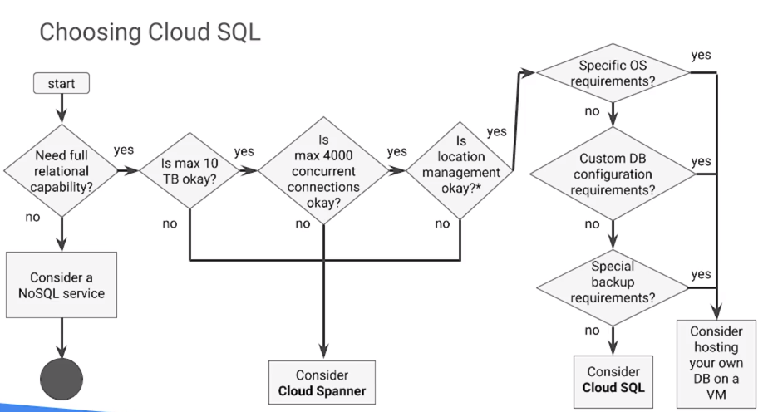
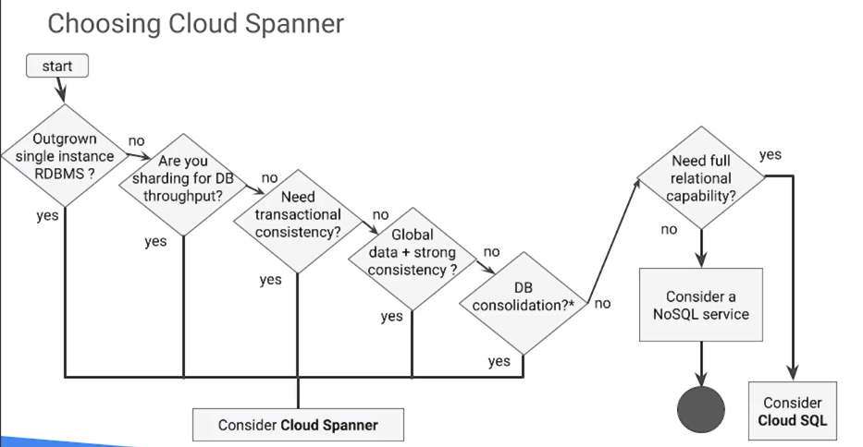
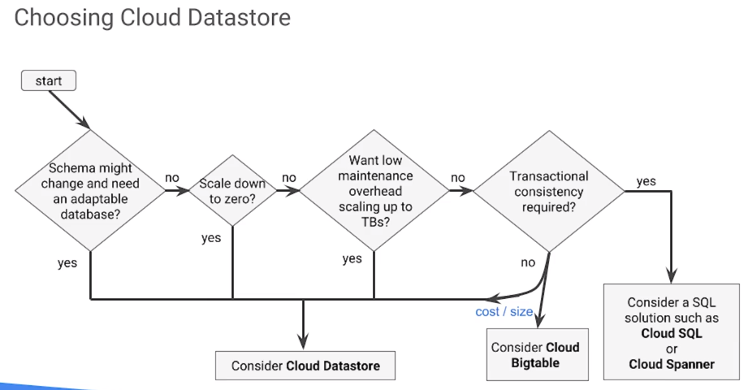
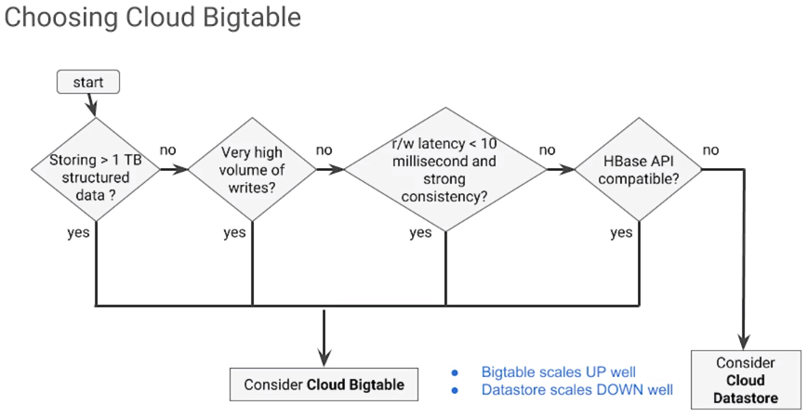
GCP data storing services
Cloud Datastore可以想象成一个巨大的CSV，同时也支持SQL语言
For unstructured data,
How to decide which to use.
For structured data, how to choose what to use
When to use Cloud Spanner?

Slide 18
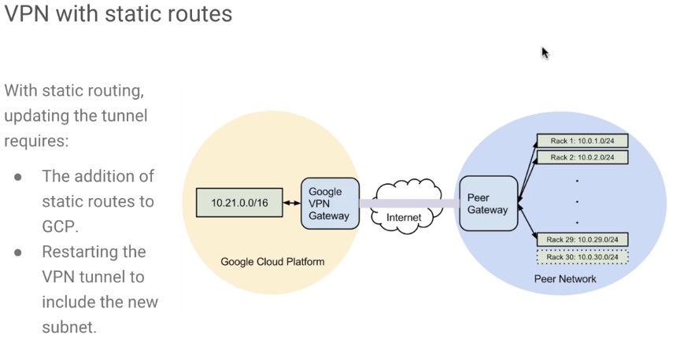
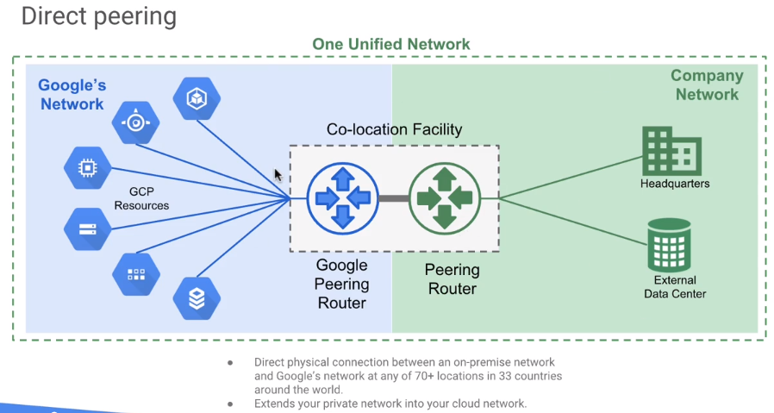
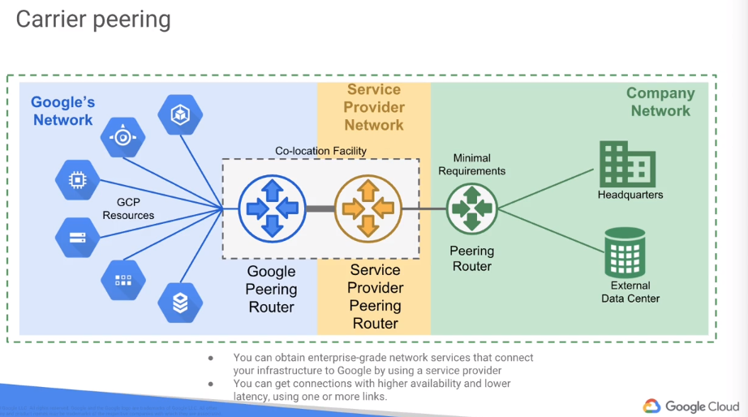
Scaling and automation using GCP
Cloud Router: design to provide BGP routing
It implements dynamic VPN that allows topology to be discovered and shared automatically, which reduces manual static route maintenance
Cloud interconnect: to transfer large amount of data between networks. 简单来说，就是有自己的hardware，希望把自己的hardware连接到Google的network时，用这个
External Peering: include direct peering and carrier peering
Cloud interconnect and direct peering can provide higher availability, lower latency, and lower cost for data-intensive applications.

Slide 19
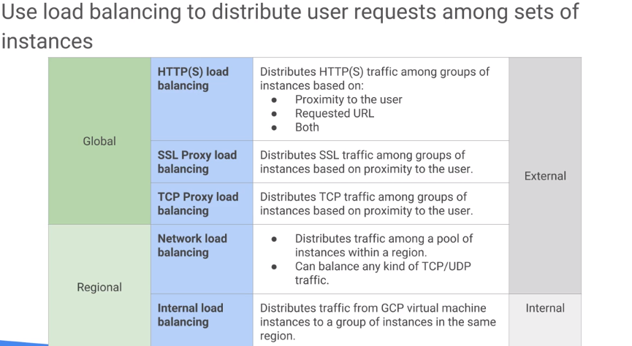
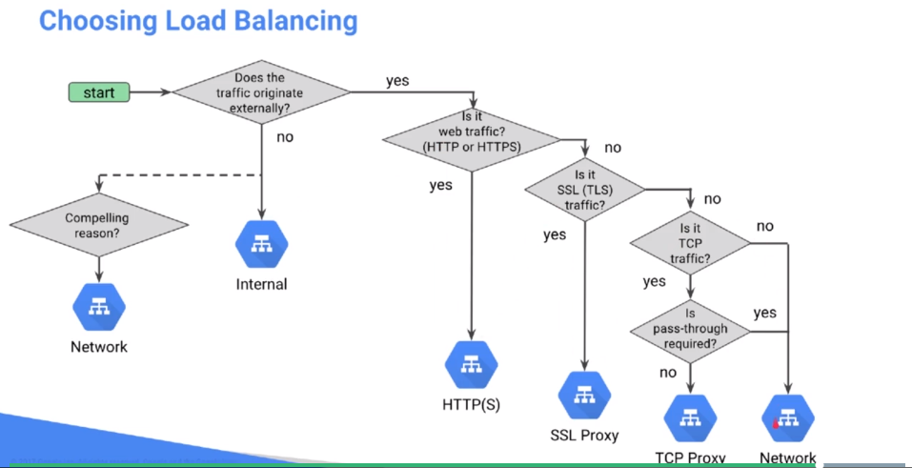
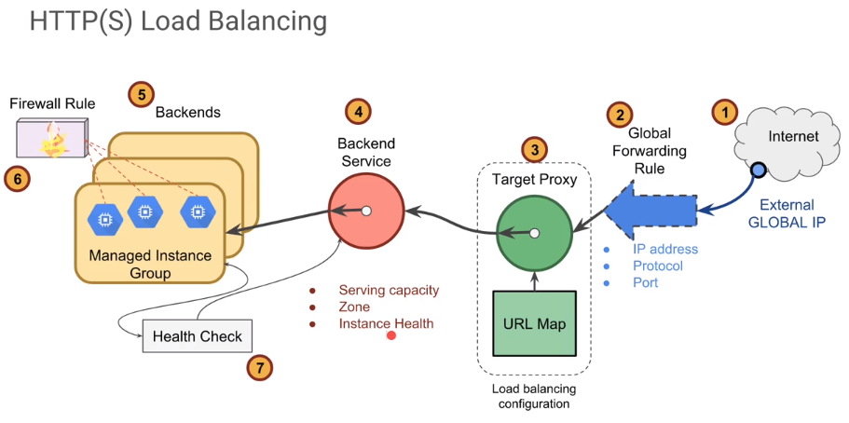
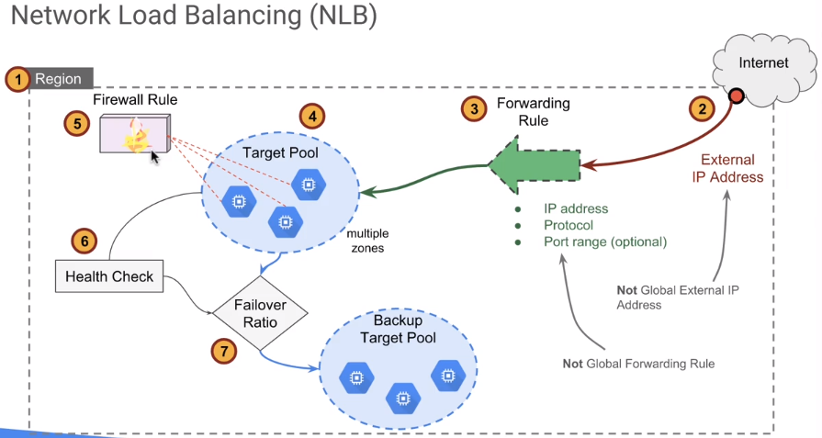
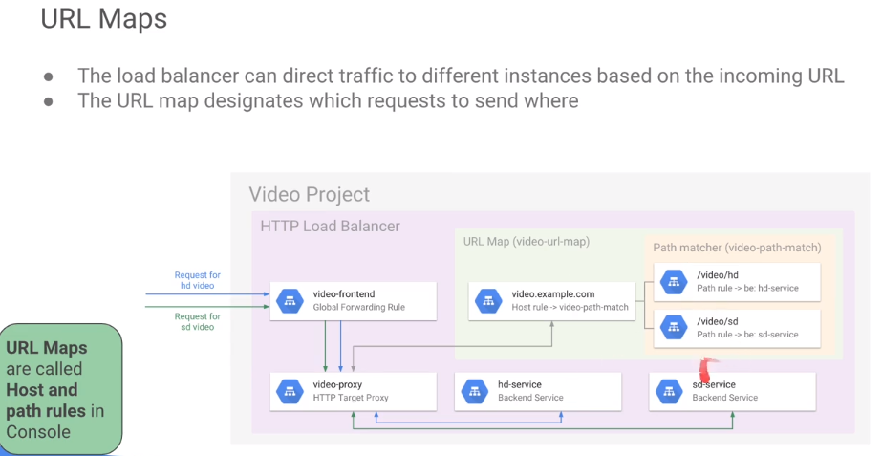
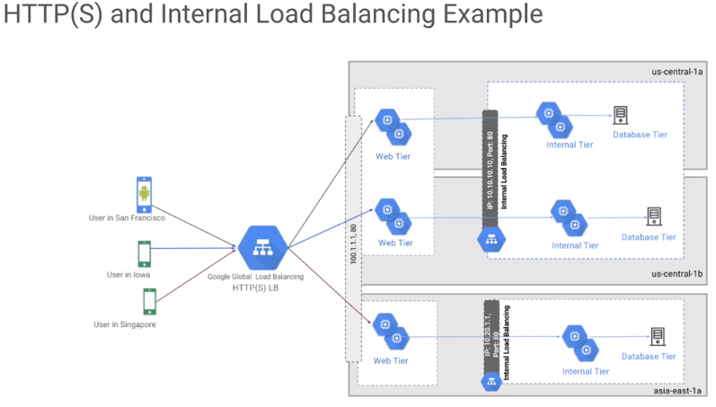
建立managed instance group的时候，最好先做一个custom image (里面安装有需要的app)
这样group在autoscale VM的时候，就可以用那个custom image创建VM了
Internal load balancing只分流负责GCP内部来的requests (只与internal IP有关)
Load balancing负责从GCP外面来的requests(从external IP来的requests)
Load balancing:
3 categories: global external load balancing, regional external load balancing, and regional internal load balancing
There is hardware load balancing
需要先创建managed instance group (有autoscaling功能)
Managed instance group的好处是高度自动化，如果user添加了一个新的instance进group，managed instance group会自动分配工作给这个instance
HTTP(S) load balancing
Cross-region and content-based load balancing
Both are HTTP/HTTPS only
SSL proxy/TCP proxy
Both Use Google Cloud Load Balancing as a gateway, which rely the traffic to different zones/instances
Network load balancing
Work better if target pool has managed instance group
右图是一个video的server，根据来的request是HD video request还是Standard Video request (根据URL header区分)，URL map告诉proxy把request转到不同的backend
这里的forwarding rules可以是根据port的，也可以是根据IP的，protocol的, etc.
Google Global Load Balancing (a.k.a HTTP(s) load balancing)先把traffic分给各个region，然后每个region的internal load balancing在分traffic给各个instance

Slide 20
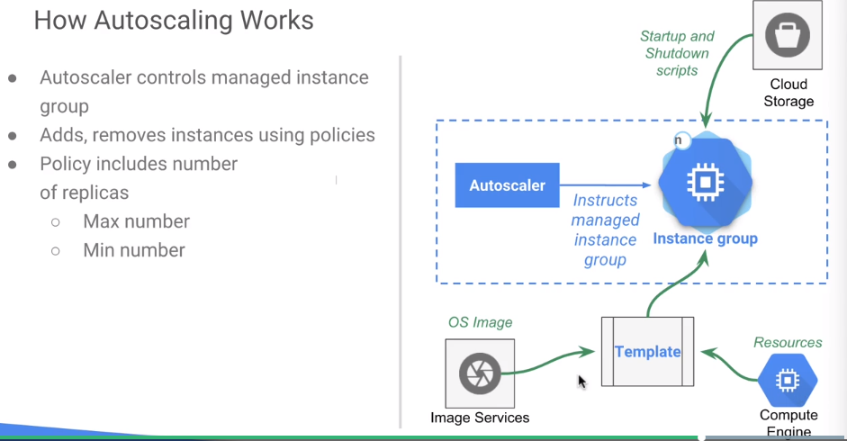
Autoscaling
1 autoscaler per managed instance group
Policy options
Average CPU utilization
HTTP load balancing serving capacity
Each autoscaler allow multiple policies (up to 5)
Stackdriver metrics can be used as custom metrics for autoscaling policies.
Autoscaler resolve conflicts between multiple scaling policies:
Autoscaler select the one that recommends the most VMs, to ensure the application is supported.

Slide 21










这张Slide介绍了 IPSec的ESP通信信道的config方法
本来server-1和server-2只能用双方的external IP (Global IP)来通信，但config好之后，server-1和server-2就能用双方的internal IP进行通信了，并且通信用IPSec的ESP protocol加密
3. 下面2图，是用来设置VPN-1和VPN-2各自的router，当destination-range是以下的时候，把包给各自的tunnel
例：在VPN-1中，如果有packet的dest IP是在10.1.3.0/24范围内的，就把这个packet给tunnel1to2
2. 下面2图，是用来建立VPN-1和VPN-2之间的两条通信通道的
VPN-1
Us-east1
10.5.4.0/24
VPN-2
Europe-west1
10.1.3.0/24
STATIC_IP_VPN_1
tunnel1to2
STATIC_IP_VPN_2
tunnel2to1
Server-1
10.5.4.2
Server-2
10.1.3.2
1. 下面6图，是用来config VPN-1和VPN-2各自的VPN Gateway的,VPN Gateway的目的是，当packet是ESP或UDP500或UDP4500时，把packetforward给各自的STATIC_IP_VPN_? (VPN Gateway就是来handle所有IPSec通信)
IPSec用UDP 500和4500来通信

Slide 22


Automating Infrastructure
Custom image
Backed image – with software preinstalled, fast
Golden image – configs are done
Instance template
Used in managed instance group, to create same VMs
Difference between snapshot and custom image
Snapshot is locked in a project, custom image can be shared between projects
Deploy manager
Cloud launcher is a place to list all the deployments
Accetp .yaml, python, jinja2 files
Deployment manager templates: can be nested, have properties, and can use environment variables
Managed services
Data processing managed services
Dataproc, 和spark等big data相关功能
dataflow,
Bigquery
how to create snapshot
Create a VM, config “do not delete disk when delete instance”
Do something on VM
Delete VM, then goto “Disks”, you can find your disk there
Create … of the disk to create a snapshot
And then you can create a disk from the snapshot, and then create a VM from the disk
Managed services

Slide 24


Reliable Cloud Infrastructure: Design and Process
Aspects to think in cloud-based designing

Slide 25


First thing to consider when designing a cloud based service,
Should the service be stateful or stateless?
Following figure is a good design to place state info,
Do NOT put state info in frontend, instead put the info to backend!

Slide 26

How to measure a service?
To measure a service, first define Level of Service
Service level indicator (SLI)
Throughput, latency, availability, etc.
Users should be able to directly monitor this. (User observable indicators!)
Service level objectives (SLO)
Threshold, e.g., lowest performance allowed
Technical objectives
Also called ”user pain tolerance”
Focus on: latency, traffic, errors and resource usage
Service level agreements (SLA)
For very critical services only
Business & legal agreement
User persona (e.g., power users, casual users’ concerns, etc) can help decide the SLI, SLO and SLA.

Slide 27



First step to gather requirements: asking questions!
Third step to making requirements: 想想将来的发展!
Second step to making requirements: 设定具体数值!

Slide 28
After requirement gathering, design Business logic layer
Business logic (or domain logic) is the part of the program that encodes the real-world business rules that determine how data can be created, stored and changed. (关于data的处理方式的rule)
GCP’s Cloud Function is good microservice,
When building services, think about App Engine (GAE) first, then Kubernetes Engine (GKE), after that Compute Engine (GCE)
GAE – Code first, no need to care about others
GKE – containers,
GCE – very processing efficient
Think horizontal scaling (准备很多同样的component) earlier, before vertical scaling (添加新机能给一个component来处理更多东西)
Design first, dimension later when using Cloud

Slide 29


After business logic, design Data layer
Data layer include data persistence mechanisms, and data access layer that encapsulates the persistence mechanisms and exposes the data
从user的角度来看，只关心data access和persistence
下图是GCP提供的storage类型，根据需求不同来选择不同的storage类型

Slide 30

After that, design Presentation layer
Deal with the flow of data through the system, between user, business-logic, and storage service. (meaning presentation layer is about network design)
Presentation layer is about Location, load balancing and caching
GCP和其他cloud provider并用的时候的设计方法

Slide 31

To deal with software failure, use Modularize, monitor, test, canary.
A system failure can be caused by loss, this kind of failure can be categorized into:
Failure due to loss of resources
Single points of failure
N+2 principle, to have one unit out for upgrade and survive another failing
Correlated failures: A fails cause B to fail, then C, D, E, …
Create failure domain, the group of related items that can fail together
Cascading failure: single failure may result in other failures throughout a network.
A system failure can also be cause by overload,
Prevention is the best strategy. Monitor is a good way to prevent.
To cope with failures,
To have a team for that. Prepare the team using simulation sessions.
The steps are: investigate using monitoring and diagnostics -> determine the cause (loss or overload) -> present strategies to fix
Following methods to use,
Redesign, remove risky component
Prevention, to ensure possible failure does not occur
Detection and mitigation, detect failure before or as it is happening
Graceful degradation, make sure not falling completely
Repair,
Resilient design应该从以下几个方面考虑
Use health check to monitor
auto-replace failed instances (auto horizontal scaling)
Redundant storage (multiple zones)
Load balancers to monitor and distribute traffics
How to deal with major outage (incidence response的基本)
Appoint one person to be in charge of response,
Communicate, let customers know whom to contact
Clean up loose ends during incident response
Prepare postmortem report
Determine root cause
User可以recover
Engineer可以recover
admin可以recover
回收站mechanism

Slide 32




然后，不要把vm暴露出来，前面放个bastion host(?)来隐藏
Design for security, 从以下以及方面考虑,
Network access control and firewall
Network level access control
Denial of service
Autoscaling,
Cross-region overflow, 把一个region的traffic给另一个region (absorb the attack)
Resource sharing/isolation
Isolation (VPC), if one vm is hacked, make sure the 2nd will not be hacked
Encryption and key management
Identity access and auditing (log access)
IAM policies, service account
首先，firewall要有
Ingress/egress
哪个client可以干啥
哪个Vm可以对哪个vm干啥

Slide 33

Capacity planning and cost,
Basically to get money needed for the system,
Forecast,
What was the prediction last time
Compare with actuals
Account for error in the predication model
Allocation, resource:capacity, 为了达到一个capacity数值，需要更大的resource数值
Base on forecast, estimate capacity
Validate the estimates
Calculate resources required based on the allocation ratio
Identify improves: cache, tuning, better algorithm, alternative service, etc.
Approve
Use SLO, SLI, numbers to prove the number/money
Deploy
Test before deploy,

Slide 34

Deployment
To create a checklist for deployment
Dependencies
External and 3rd party
Plan for capacity
Verify overload handling procedures
SPOFs (signal point of failure)
Security and access control
Rollout plan
Gradual, staged/phased
Create launch automation
Configuration (YAML)
Resources (list up all resources to create)
Template (jinja2, python, YAML, etc.)
Monitoring,
Monitoring is the starting point of reliability
Push/pull method monitoring
12-factor administration and operations好像是非常base的东西，需要的时候查一下
Site reliability Emgineering
Black-box monitoring: from user’s point of view, no knowledge about backend
White-box monitoring: from developer’s point of view, know everything

Slide 36

Google relavent knowledge:
以前google的广告有两个分类，一个是adwords，另一个是adsense；但最近adwords更名叫ads了，图标见右
Google Ads program enables you to create advertisements which will appear on relevant Google search results pages and our network of partner sites. 用自己的语言概括一下，一个publisher创造自己的广告，然后把自己的广告放在google ads上，这个广告就会出现在Google旗下的网站上；advertiser付钱给Google
Google AdSense program differs in that it delivers Google Ads ads to individuals‘ websites. Google then pays web publishers for the ads displayed on their site based on user clicks on ads or on ad impressions, depending on the type of ad. 用自己的语言概括一下，就是其他网站所有者可以用adsense来展示Google的广告，Google会根据点击量等付钱给网站所有者(web publisher)

Slide 37
YAML is a templating language. YAML files are used for configuration of many Google Cloud Platform services
Also used to configure Deployment Manager
Deployment manager的主要作用是，the ability to quickly create identical deployments is useful when you need identical environments for development, unit testing, load testing, production, and so forth.

